Slide 1
Monte Carlo solver for neutron transport in finite slab geometry
Milos Atz
NE155 Final Project
May 10, 2015

Slide 2
Problem Description and Geometry
Plane
Source
Interface
Vacuum
Region 1
Region 2
Vacuum
x = a
x = x_{s}
x = x_{I}
x = b
X

Slide 3
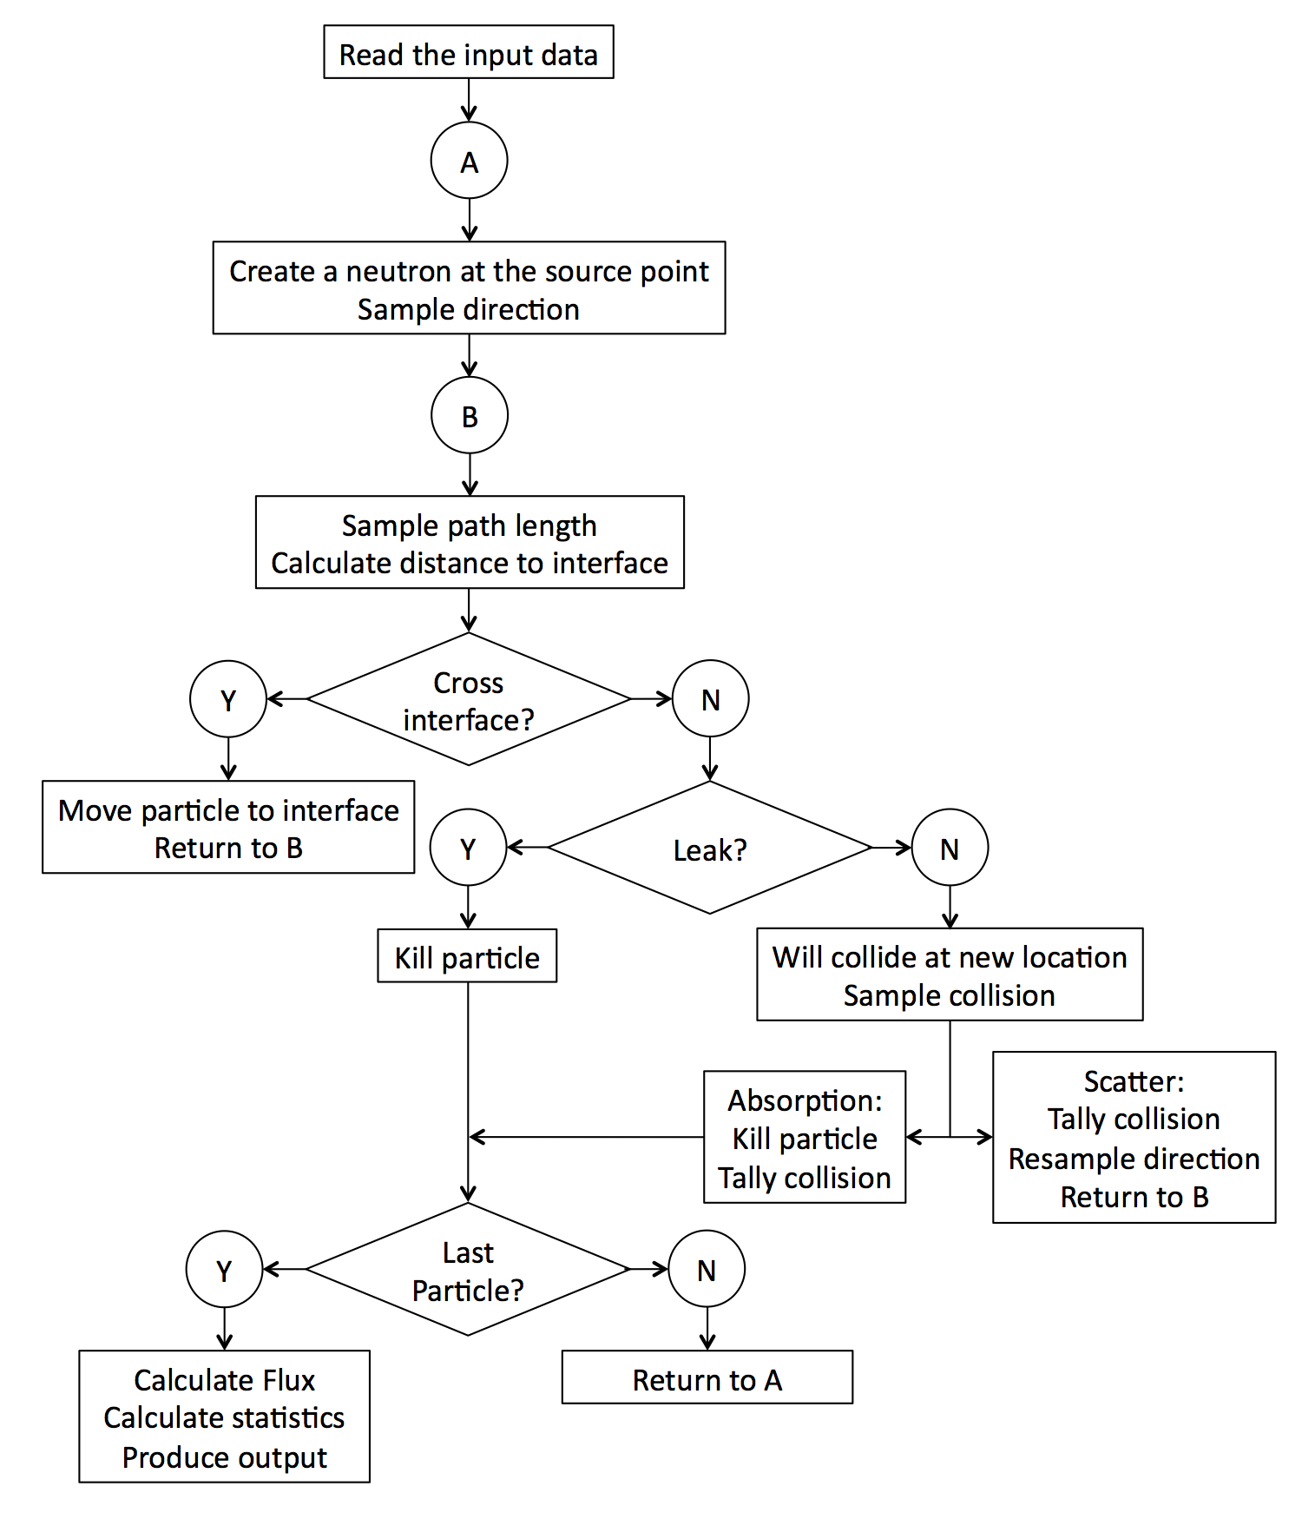

Slide 4
Sampling Routines
Sampling direction
Generate a random number ξ on the uniform distribution [0, 1).
If ξ < 0.5, direction = left (-)
else, direction = right (+)
Sampling path length
Generate a random number ξ on the uniform distribution [0, 1).
Plug into inverted CDF for path length:
Sampling angle
Isotropic source and scattering; angle can range from [0, 2π].
Interested in cosine of angle [-1, 1].
Direction covers half of angle space; reduce sampling of cosine of angle to [0, 1].
Generate a random number ξ on the uniform distribution [0, 1).
ξ multiplied by the direction is the cosine of angle
Sampling reaction
Two reactions possible: scattering (s) and absorption (a).
Probability of reaction i:
Generate a random number ξ on the uniform distribution [0, 1).
If ξ ≥ P_{s}, neutron is absorbed.
Else, it scatters

Slide 5
To resolve a collision tally over space, a spatial tally mesh is used for scoring and statistics.
x = a
x = b
Bin size is specified by the user
For each neutron history i, a score vector is initialized corresponding to this spatial binning. Each score corresponds to a collision of particle i.
Score(i) =
Once the history is complete (the particle is terminated):
The score is added to a cumulative score (a vector of equal size representing the sum of all previous histories). Each entry is given by:
The score in each bin of the score vector is squared and added to a vector containing the cumulative sum of the squares of the scores.

Slide 6
After N histories, sum of the scores and squares of scores in each bin are used to calculate the flux and statistics in each bin.
Flux
Statistics:
Sample Variance
Estimated Variance of Mean
Relative Error

Slide 7
The method can be validated by solving the diffusion equation for a simplified system (finite slab, plane source).
Two solution are required for flux on each side of the plane source.
Assume steady state, homogeneous material properties
Boundary conditions for each region are:
Vacuum at slab boundaries (a and b)
Constant current at the source
This solution can be adjusted to allow for the source to be anywhere in(a,b)

Slide 8
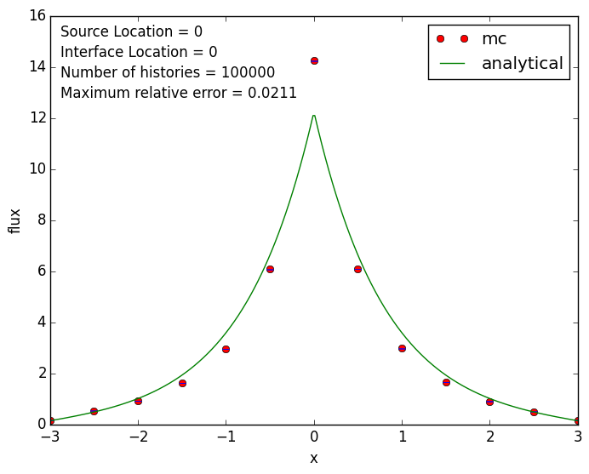
Comparison of the analytical diffusion and MC solutions for the flux
x_{source} = 0 Cross-sections equal in each region:
x_{interface} = 0 Σ_{t}(1) = Σ_{t}(2)
a = 3, b = -3 Σ_{s}(1) = Σ_{s}(2)
S = 10

Slide 9
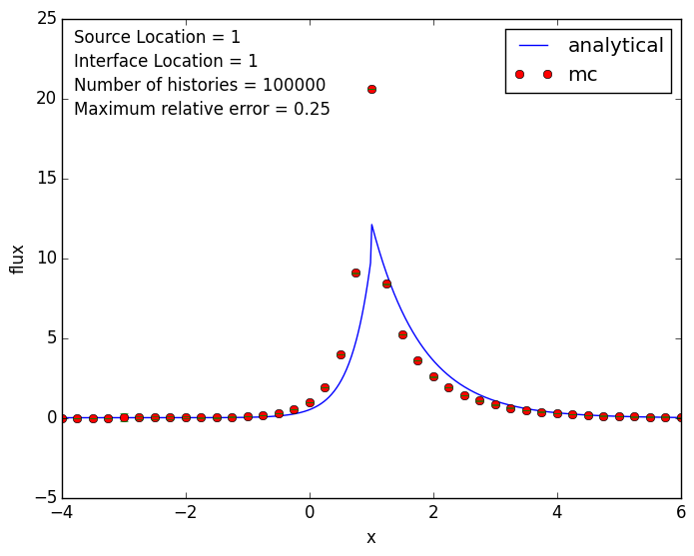
Comparison of the analytical diffusion and MC solutions for the flux
x_{source} = 1 Cross-sections equal in each region:
x_{interface} = 1 Σ_{t}(1) ≠ Σ_{t}(2)
a = -4, b = 6 Σ_{s}(1) ≠ Σ_{s}(2)
S = 10

Slide 10
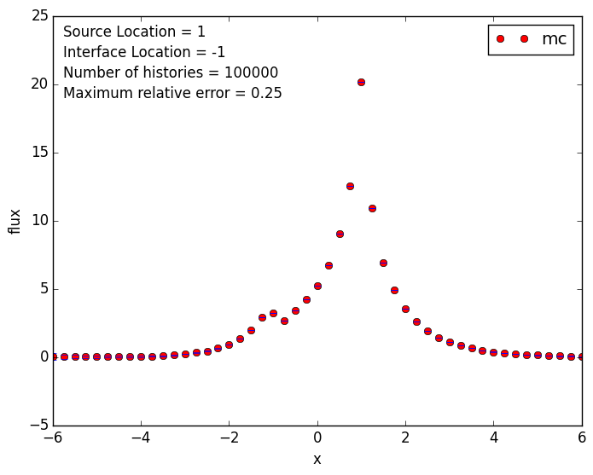
Comparison of the analytical diffusion and MC solutions for the flux
x_{source} = 1 Cross-sections equal in each region:
x_{interface} = -1 Σ_{t}(1) ≠ Σ_{t}(2)
a = -6, b = 6 Σ_{s}(1) ≠ Σ_{s}(2)
S = 10

Slide 11
References
[1] MCNP5 - A General Monte Carlo N-Particle Transport Code, Version 5. Volume 1: Overview and Theory. X-5 Monte Carlo Team, Los Alamos National Laboratory (rev. 2008).
[2] J. J. Duderstadt, L. J. Hamilton. Nuclear Reactor Analysis. John Wiley & Sons, Inc. 1976.

